Slide 1
Attention Mechanism and Transformer
Thanh-Sach LE
LTSACH@hcmut.edu.vn
Faculty of Computer Science and Engineering
Ho Chi Minh City Univ. of Tech., HCM-VNU
October, 2022

Slide 2
Content
Attention and Transformer
Summary
Machine Translation

Slide 3
Machine Translation
Conditional Distribution:
(vocab-size,)
P(next-word | Inputs, previous-predicted-words)
Softmax
Linear
Encoder #N
Decoder #N
…
…
Encoder #2
Decoder #2
Encoder #1
Decoder #1
Positional
Encoding
Positional
Encoding
+
+
Embedding
Embedding
Inputs
Outputs

Slide 4
Machine Translation
Conditional Distribution:
(vocab-size,)
P(next-word | Inputs, previous-predicted-words)
Translation Model
Inputs
translate to
HOW?
Outputs
Tôi thích kỹ thuật học sâu
I like deep learning technique
1. Encode(Tôi thích kỹ thuật học sâu)
2. Decode(<START>) → I
3. Decode(<START> I → like)
4. Decode(<START> I like → deep)
5. Decode(<START> I like deep → learning)
6. Decode(<START> I like deep learning → technique)
7. Decode(<START> I like deep learning technique) <EOS>
8. Stop, return: I like deep learning technique

Slide 5


Encoder >>
Shape: (batch-size, ntokens, nfeatures_out)
LayerNorm
$$+$$
Linear
LayerNorm
$$+$$
Multi-heads Self-Attention
V
K
Q
Shape: (batch-size, ntokens, nfeatures_in)

Slide 6
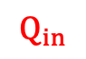
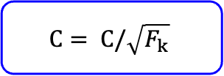
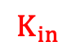
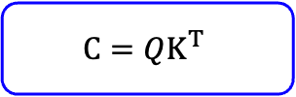
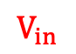
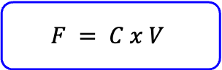
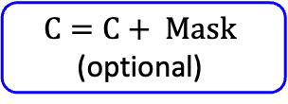
Multi-heads Self-Attention
Linear
$$F = C x V$$
Concat(= Reshape)
C = Softmax(C)
along row
Scaled Dot-Product Attention
$$C=C+ Mask$$
(optional)
V
K
Q
$$C= C/\sqrt{F_{k}}$$
Reshape
Reshape
Reshape
$$C=QK^{T}$$
Linear
Linear
Linear
$$V_{in}$$
$$K_{in}$$
$$Q_{in}$$
V
K
Q
Note:
Reshape: actually = reshape, then transpose
Concate: actually = transpose, then reshape
Mask: contain 0 or –inf

Slide 7
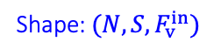
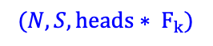
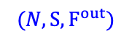
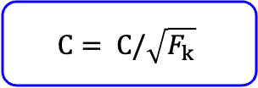
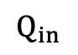
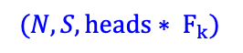
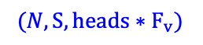
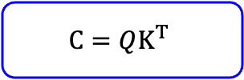
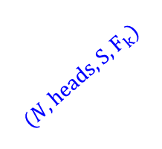
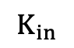
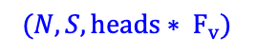
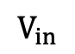
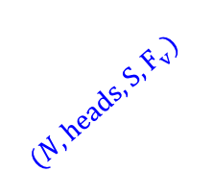
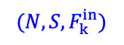
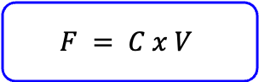
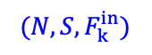
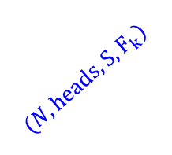
$(N, S,F^{out})$
Linear
$$F = C x V$$
$(N, S, heads∗F_{v})$
Concat(= Reshape)
C = Softmax(C)
along row
Scaled Dot-Product Attention
C = Mask(C)
(optional)
V
K
Q
$(N, heads, S, F_{v})$
$(N, heads, S, F_{k})$
$(N, heads, S, F_{k})$
$$C= C/\sqrt{F_{k}}$$
Reshape
Reshape
Reshape
$(N, S, heads∗ F_{v})$
$(N, S, heads∗ F_{k})$
$(N, S, heads∗ F_{k})$
$$C=QK^{T}$$
Linear
Linear
Linear
$$V_{in}$$
$$K_{in}$$
$$Q_{in}$$
V
K
Q
Shape: $(N, S, F_{v}^{in})$
$(N, S,F_{k}^{in})$
$(N, S,F_{k}^{in})$
Note:
Reshape: actually = reshape, then transpose
Concate: actually = transpose, then reshape

Slide 8

Decoder >>
LayerNorm
$$+$$
Linear
LayerNorm
$$+$$
Encoder-Decoder Attention
V
K
Q
From the last encoder
LayerNorm
$$+$$
Multi-heads Self-Attention
V
K
Q

Slide 9
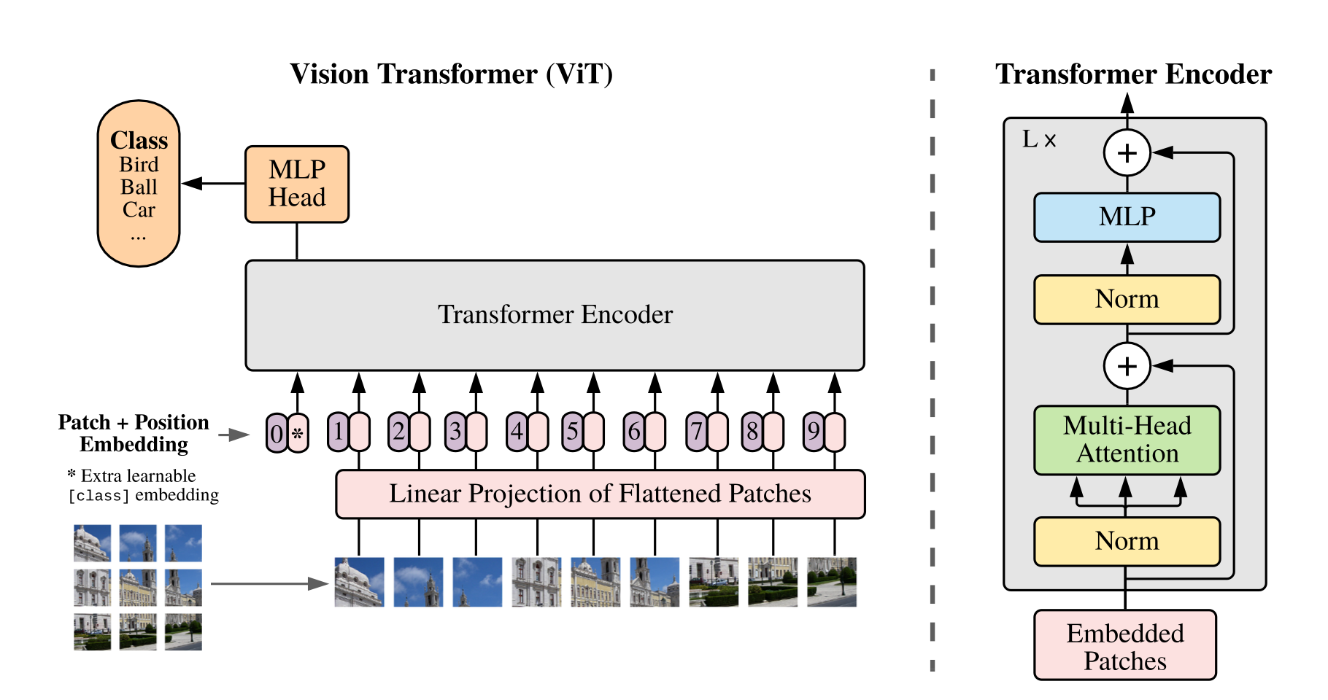
Vision Transformer (ViT)

Slide 10
References
Attention Mechanisms — Multi-Head attention (with code)
”https://medium.com/@smitasasindran/12-attention-mechanisms-multihead-attention-958041a35553
Transformers Explained Visually (Part 2): How it works, step-by-step
https://towardsdatascience.com/transformers-explained-visually-part-2-how-it-works-step-by-step-b49fa4a64f34
How Transformers work in deep learning and NLP: an intuitive introduction
https://theaisummer.com/transformer/
Attention Mechanisms and Transformers (with code)
https://d2l.ai/chapter_attention-mechanisms-and-transformers/multihead-attention.html#sec-multihead-attention
Keras, ViT
https://keras.io/examples/vision/image_classification_with_vision_transformer/

Slide 11
Thank you for your listening
Welcome to your sharing and comments!
Lê Thành Sách
LTSACH@hcmut.edu.vn

